Slide 1
Huiqin Hu Personal Website
By Huiqin Hu

Slide 2
Project Description
This project is the first project of CS5610 Web Development course at Northeastern University. This is a good kickstart of my web development journey, a good exercise to equip me with knowledge on HTML, CSS, Javascript, Bootstrap, etc. Although the website is still at its beginning stage, I intend to continue updating it and eventually use this as my professional personal website so my friends, network, future employers and potential business partner could come and see the projects I have worked on in the past.

Slide 3
User Personas
Friends and network: people are care about me and wants to see my career updates and new interests
Lucy Liu, a lawyer Huiqin befriended with in her years in Wall Street, is interested to see how Huiqin’s software engineering study goes. She comes to Huiqin’s personal website and checks out the latest projects she worked on.
Future employers: people are wants to know what skills I have and if I’m suitable for the job
Disney wants to find talents who have experiences in both software engineering and media studies - they Googled and came across Huiqin’s website, and is intrigued by her multifaceted career path and extends an interview.
Potential business partner: people who are interested in starting new projects or new business ventures with me and wants to see my personality and my professional skills
Huiqin posts her resume and personal website on other social media when she thinks she is ready to join the startup life - many people sees her website and decides to reach out because they saw Huiqin as a suitable business partner to work with.

Slide 4
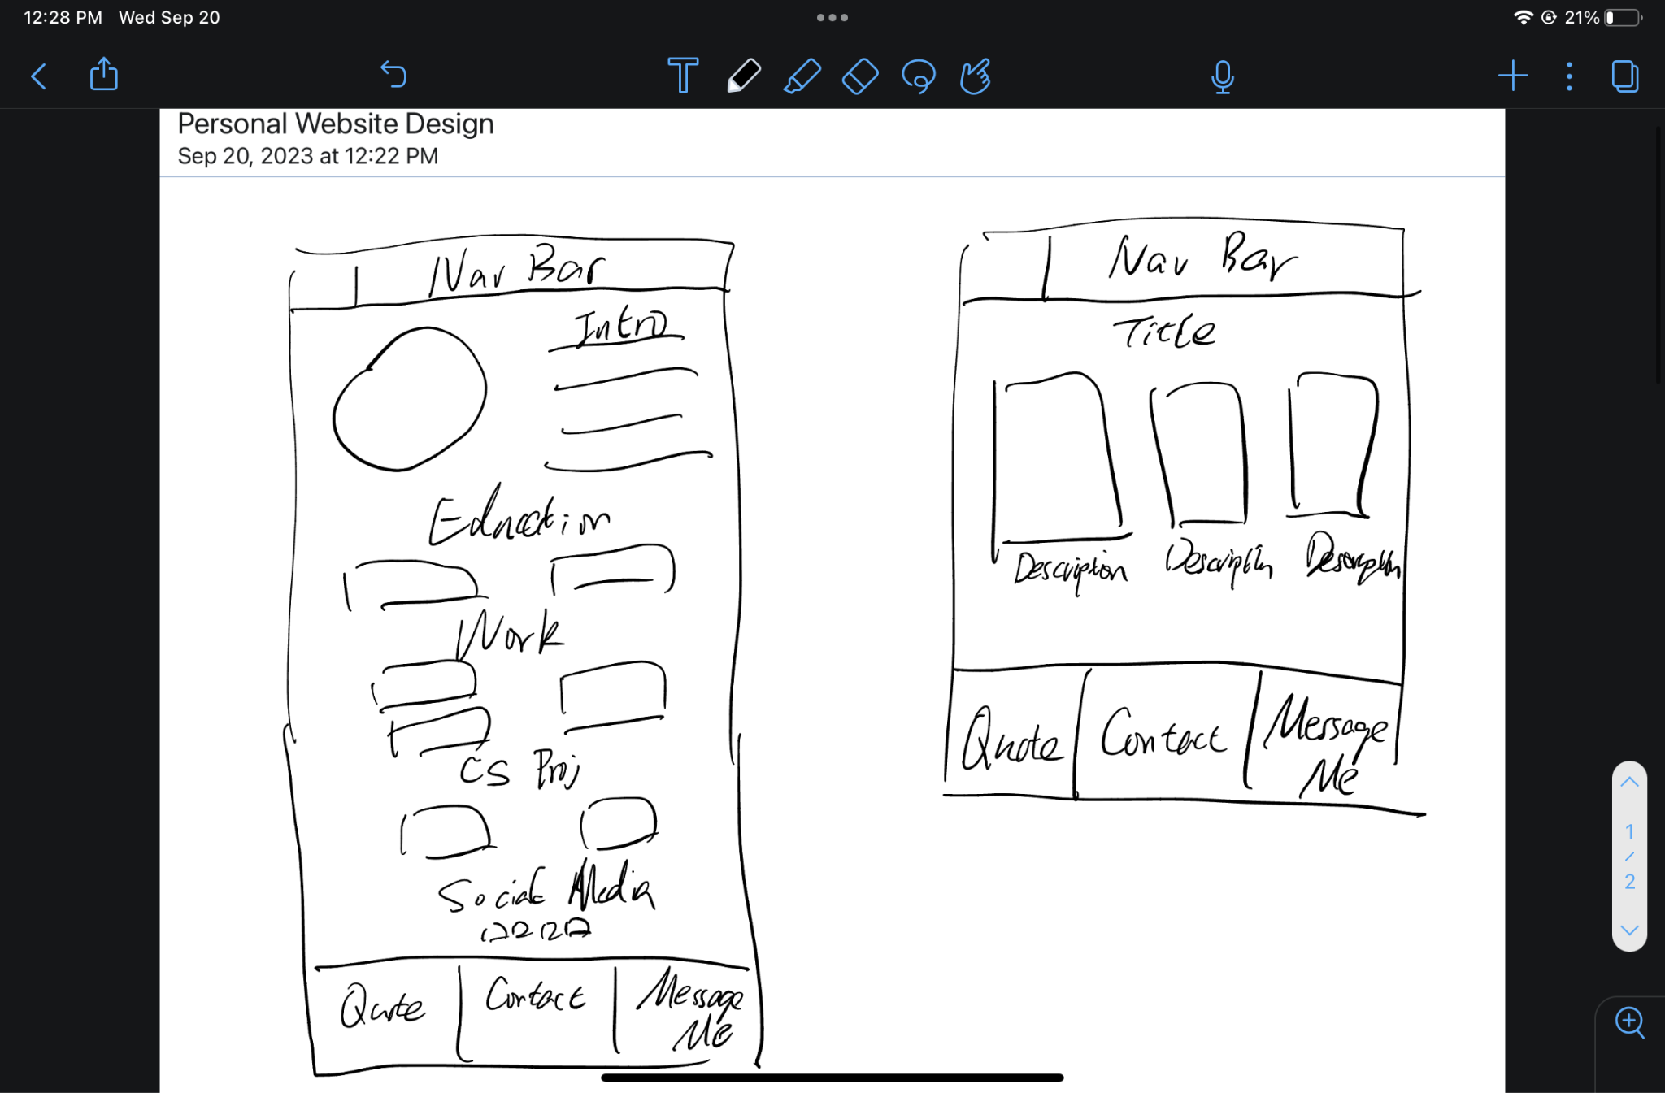
Design Mockups

Slide 5
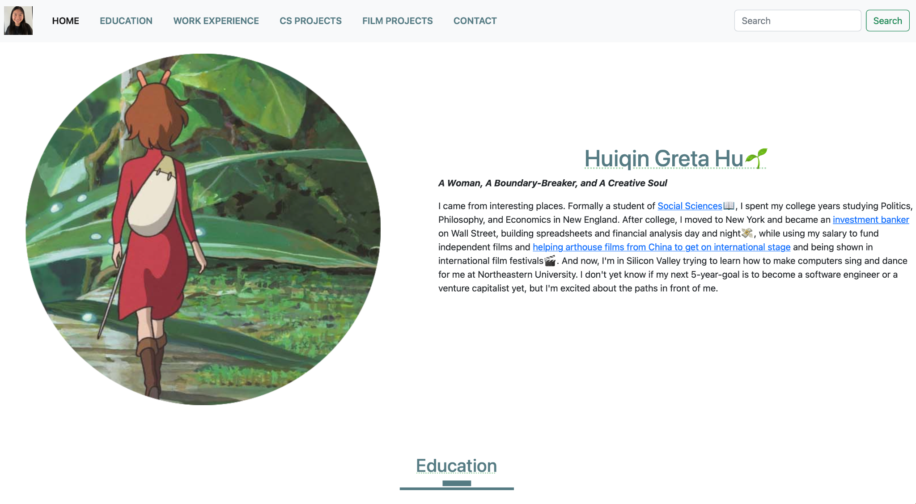
Preview

